Slide 1



Epidemic Spread Simulation
This presentation will guide you through the workings of our Epidemic Spread Simulation, a project aimed at visually modeling infectious disease dynamics.
Ivo Sardzovski-Teovski,
Konstantin Pandilovski,
Marko Petrov !

Slide 2
Introduction
What is it?
Our Goals
The Epidemic Spread Simulation is a model that simulates the spread of a disease through a population, tracking individuals in different stages of infection.
We aim to visually demonstrate how diseases spread, reach peak levels, and eventually recede. We will explore how changes in infection and recovery rates affect the simulation.

Slide 3
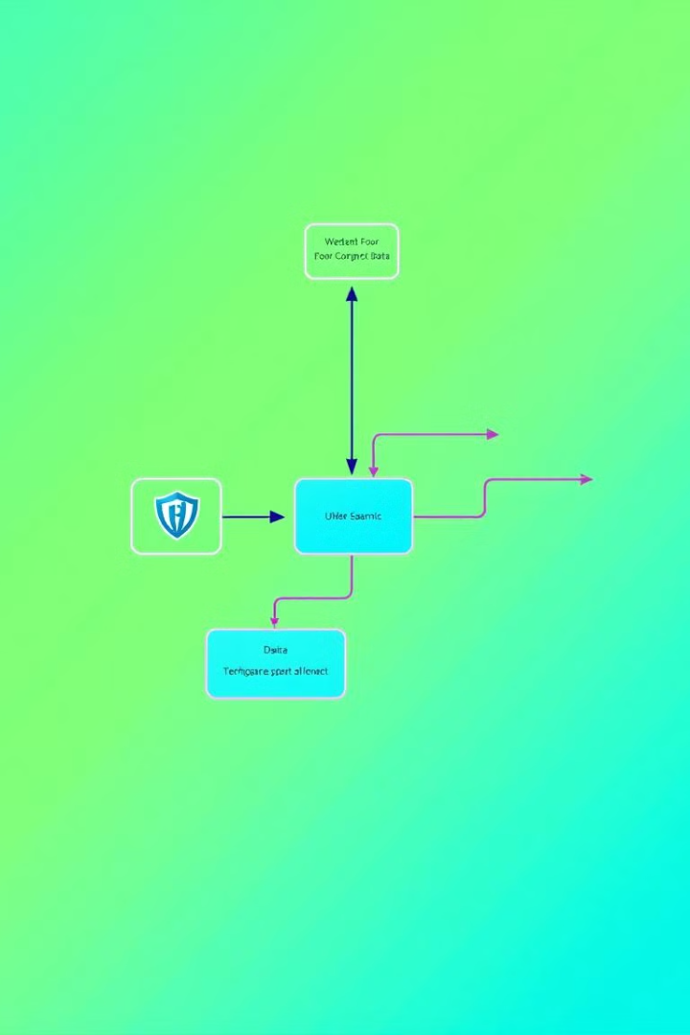
Key Features
Recursive Algorithm
Sorting Algorithm
Updates the simulation daily, accounting for changes in infection and recovery states.
Organizes individuals by their infection status, enabling analysis of different population segments.
Search Algorithms
Randomness
Analyzes data by age group and infection state, providing valuable insights.
Introduces real-life variability by using random infection and recovery rates, reflecting the unpredictable nature of disease spread.
User Input
Allows dynamic changes to infection/recovery/rates.
Daily Statistics
Tracks key metrics for each day of the simulation.

Slide 4
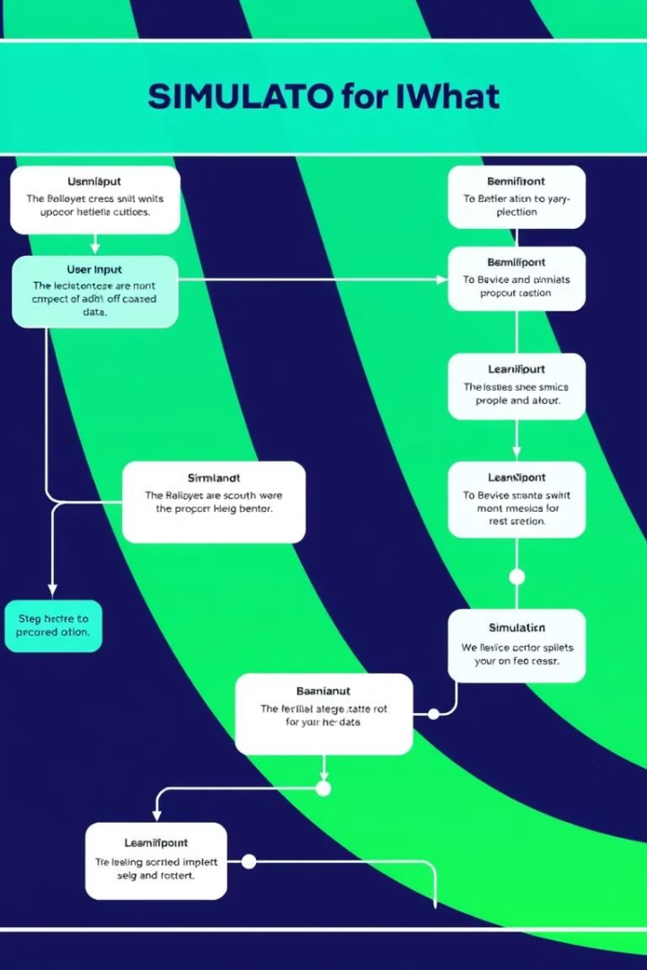
Methodology
1
The simulation starts with user input, such as the total population, initial number of infected individuals, and infection and recovery rates.
2
The recursive function iterates through each day, updating individuals' states based on infection and recovery rates.
3
The simulation utilizes sorting and search algorithms to analyze the data and provide daily summaries, including key metrics such as the number of individuals in each state (Susceptible, Infected, Recovered).

Slide 5
Recursive Algorithm
Purpose
Key Points
The recursive algorithm is responsible for daily updates to the population, tracking individual states (Susceptible, Infected, Recovered) and applying infection and recovery rates.
This algorithm continues until the user-defined number of days is reached, providing a dynamic representation of disease spread over time.

Slide 6

Sorting Algorithm
Purpose
Implementation
The sorting algorithm organizes individuals by their state (Susceptible, Infected, Recovered), allowing for efficient analysis of different population segments.
The algorithm is called after each daily simulation step, ensuring the data remains organized and readily available for analysis.

Slide 7
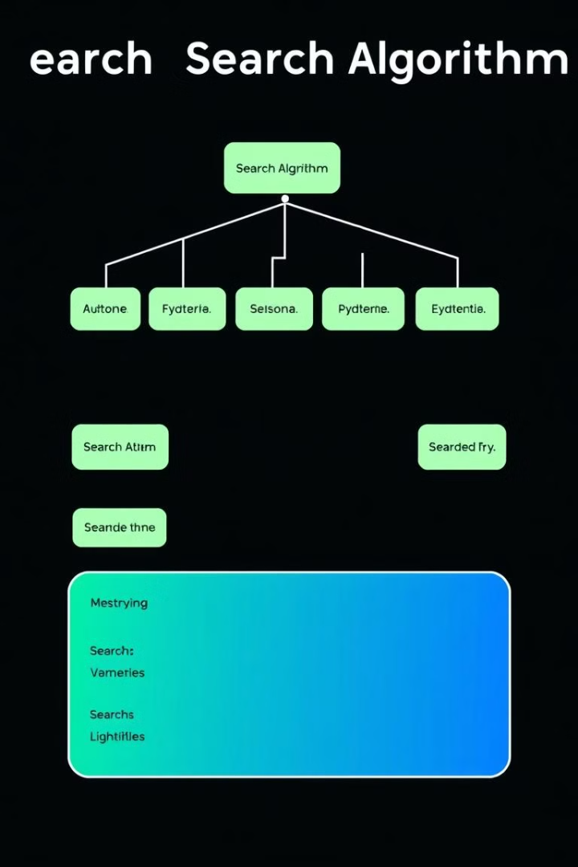


Search Algorithm
State Search
Age Group Search
Counts individuals in each state (Susceptible, Infected, Recovered), providing a snapshot of the disease's impact on the population.
Analyzes the population by age group (0-18, 19-69, 70+), revealing potential variations in susceptibility or severity of infection.

Slide 8


User Input and Randomness
User Input
Users provide key parameters such as the total population, infection/recovery rates, and simulation duration, allowing for customized scenarios.
1
Randomness
2
The simulation introduces randomness to simulate real-life variability in infection and recovery, reflecting the unpredictable nature of disease spread.

Slide 9
Simulation Results
Daily Statistics
1
The simulation provides daily statistics on the number of Susceptible, Infected, and Recovered individuals, as well as age group analysis.
Summary Report
2
A summary report presents the final distribution of states, key insights from the simulation, and potential implications for understanding disease spread.

Slide 10

CHALLENGES

Slide 11


Slide 12

Conclusion && Q&A
The Epidemic Spread Simulation highlights the importance of algorithms in modeling real-world challenges. Recursive, sorting, and search functions played a key role in tracking daily changes, organizing data, and analyzing infection patterns, offering clear insights into epidemic dynamics.

